Slide 2
1
2
3
N
. . .

Slide 3
Z₂
3
. . .
Z₃
3
. . .
Z₄
3
. . .

Slide 4
Z₂
Sweep

Slide 5
Z₂
Sweep

Slide 6
Z₂
Sweep

Slide 7
(
)
(
)
+
(
)
(
)
+

Slide 10
….
….

Slide 11
3
Z₃
Sweep
3

Slide 12
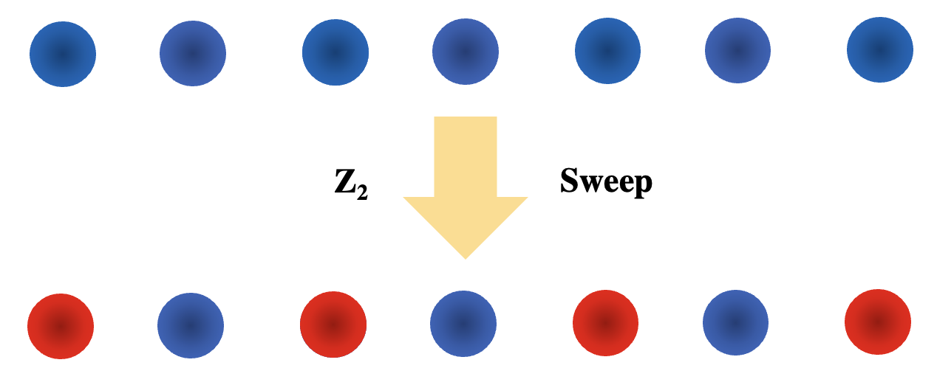
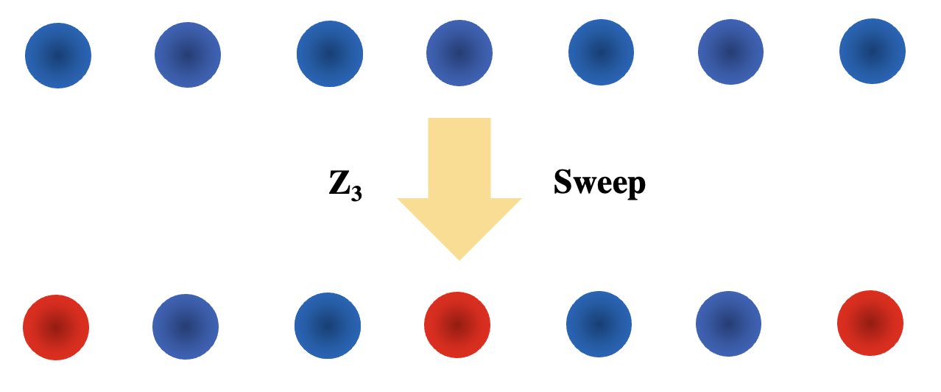

Slide 13
1
2
3
. . .
N
a

Slide 14
Optical
Tweezers
1
2
3
. . .
N
a
a
Driving
Laser

Slide 15
1
2
3
. . .
N
a
a

Slide 16
ZXCJK,L.;’\’§
R_{B}
1
2
3
a
a

Slide 17
R_{B}
1
2
3
a
a

Slide 18
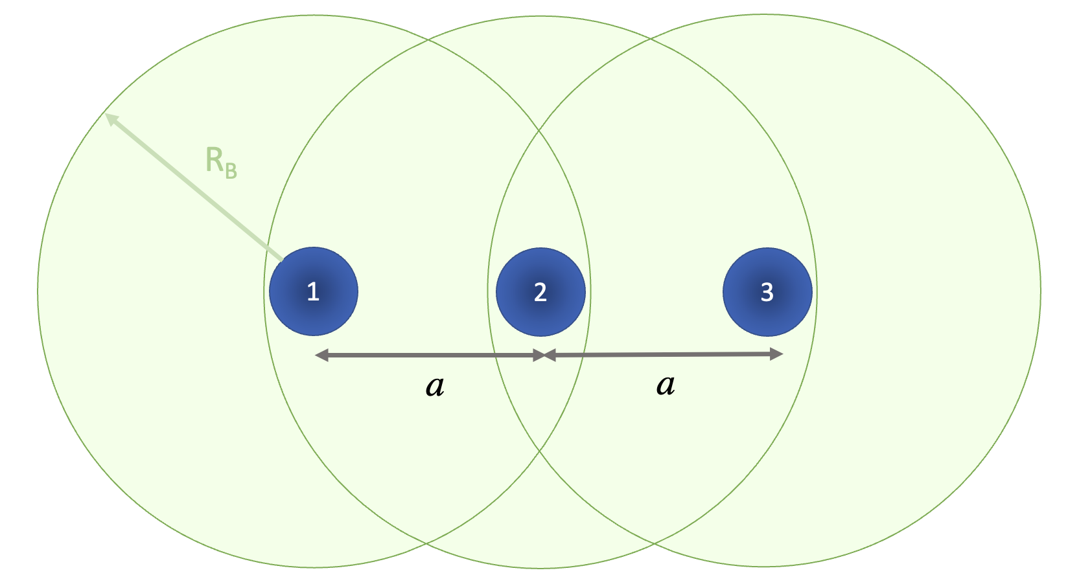
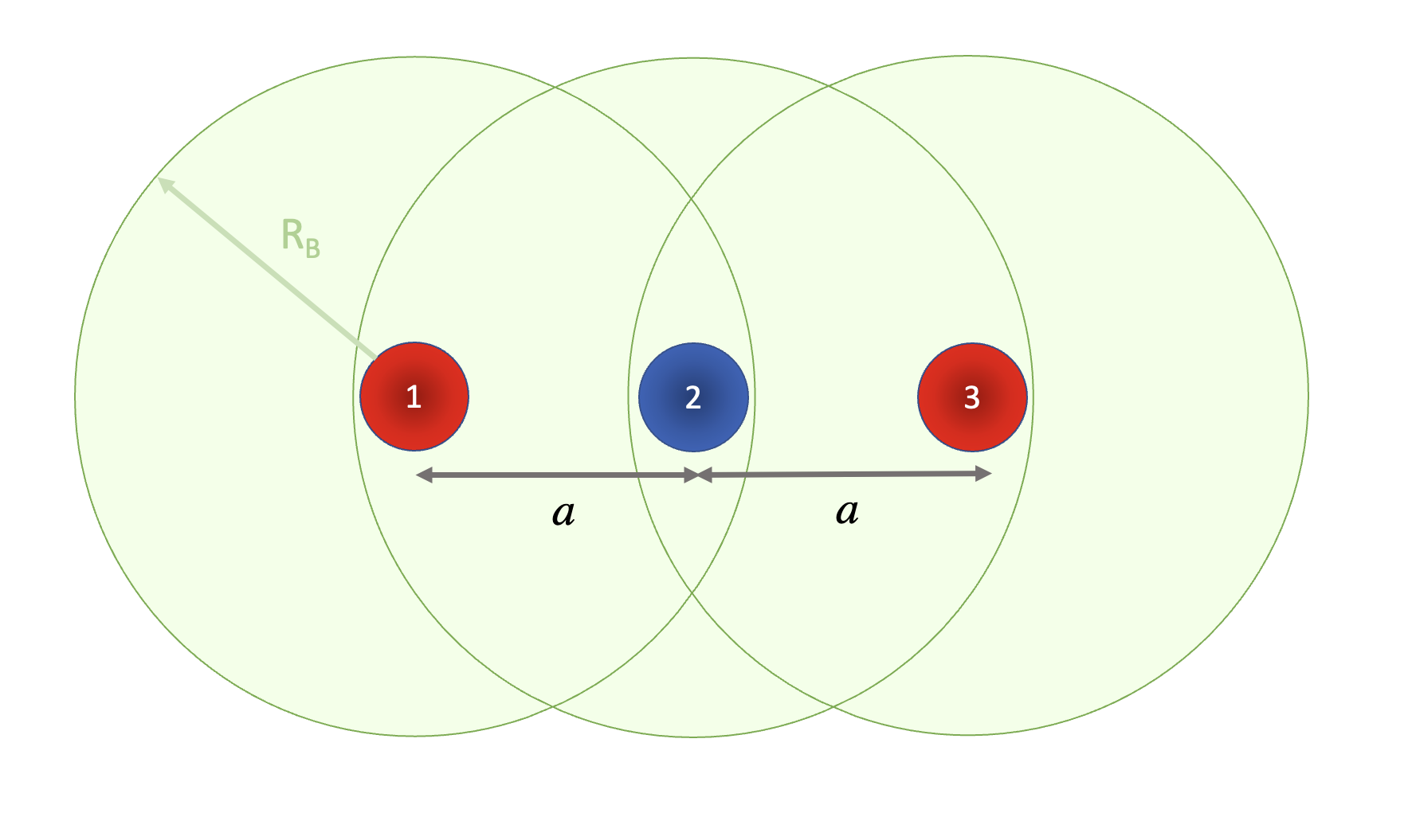
sweep

Slide 19
1
2
3
a
a

